Slide 1
DISCRETE MATHEMATIC LEC-05: Modular Arithmetic
Fall, 2020
Instructor: Dr. Hung Ta

Slide 2
Problem
The 24-hour clock numbers from 0 to 23.
Hanoi time zone: GMT +7
Hawai’i time zone: GMT -10
The time is 9:00 now in Hanoi. What is the time in Hawai’i?
9 – 17 = – 8 , but – 8 is not in the range from 0 to 23. What to do? Wrap around. The time in Hawai’i now is 16.
Notes:
2

Slide 3
Problem
In the world of computer science, we work with finite sets.
Binary digit: 0 1
32-bit integers: from −2,147,483,648 to 2,147,483,647
What if the sum of two integers is greater than 2,147,483,647?
Answer: we wrap around to 0 every time we reach 2,147,483,647
Notes:
3

Slide 4
Modular Arithmetic
The numbers used are limited to the range {0, 1, …, m-1}
m = 7
2 + 3 ≡ 5 (mod 7) 7 divides (2 + 3 – 5)
3 + 4 ≡ 0 (mod 7) (3 + 4 – 0) is divisible by 7
4 + 6 ≡ 3 (mod 7) 7 divides (4 + 6 – 3)
4 - 2 ≡ 2 (mod 7) 7 divides (4 - 2 – 2)
3 - 4 ≡ 6 (mod 7) (3 - 4 – 6) is divisible by 7
Notes:
4

Slide 5
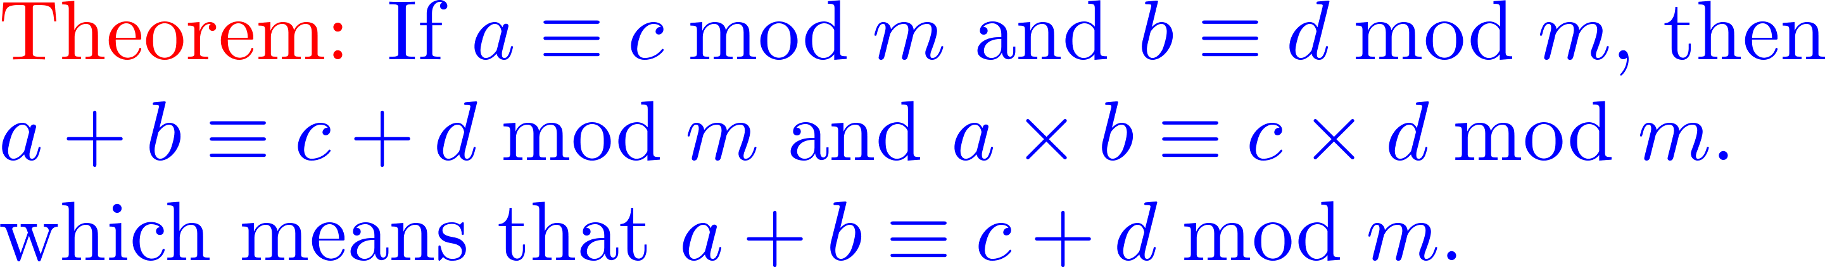
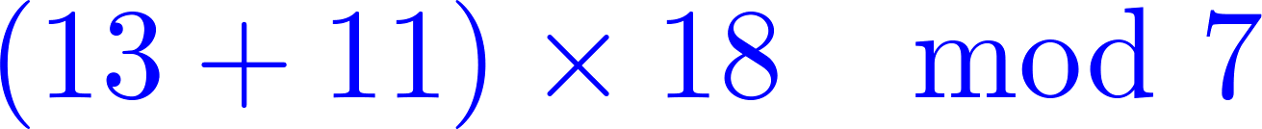
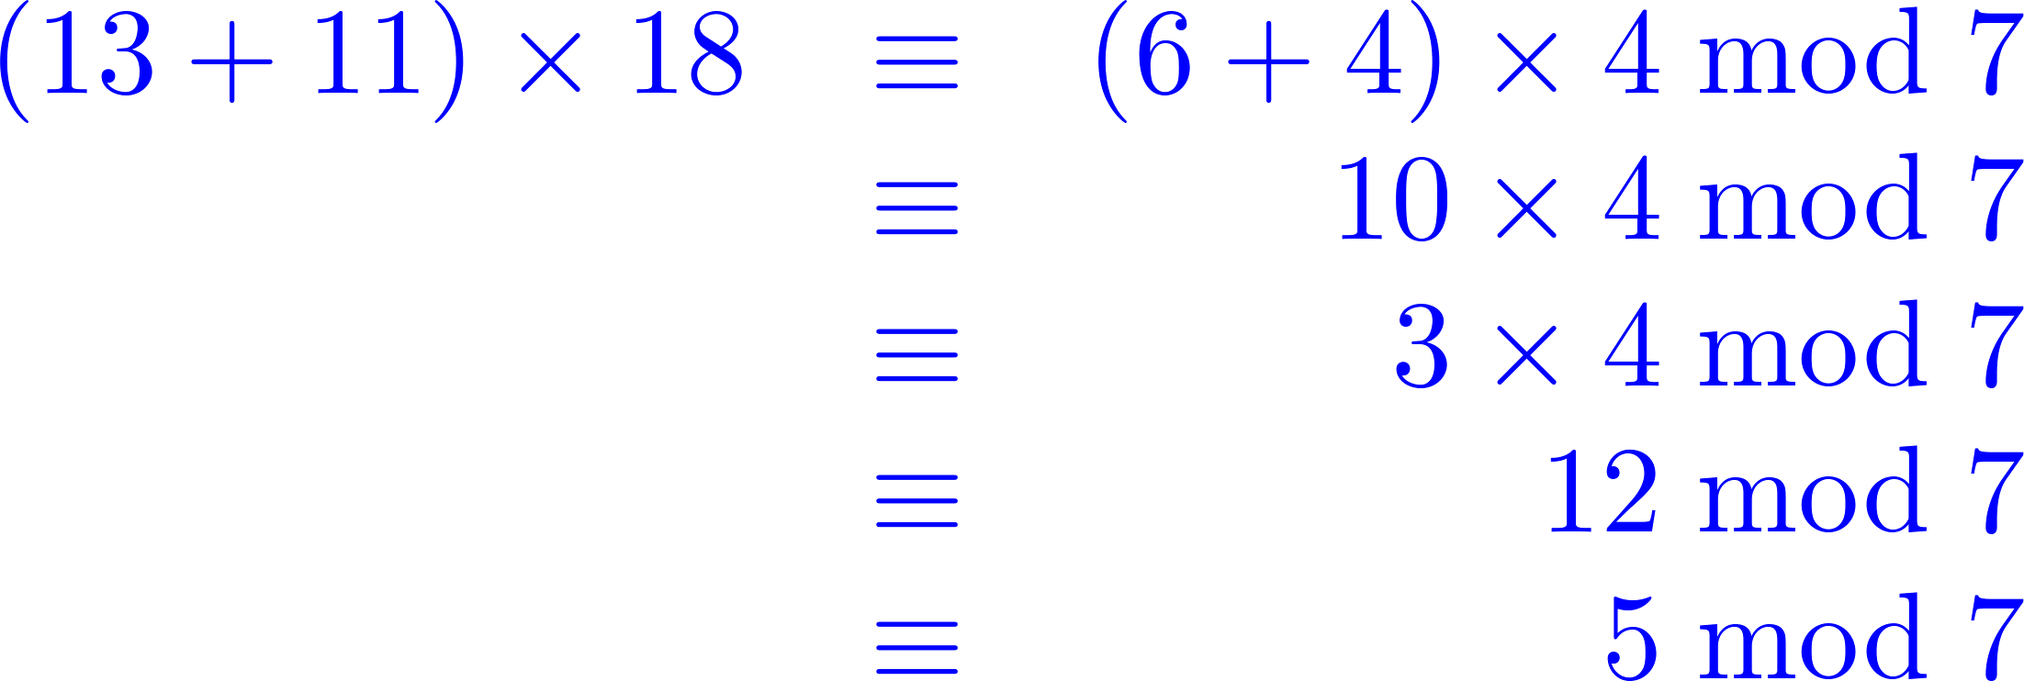
Modular Arithmetic
Consider the expression
, using the theorem several times we have
Notes:
We divide the number by 7
5

Slide 6
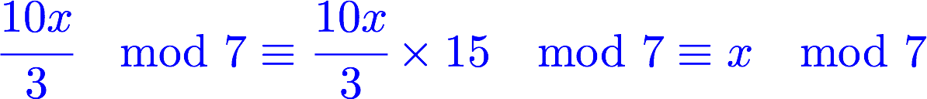
Modular Arithmetic
Addition:
Multiplication:
Notes:
We divide the number by 7
6

Slide 7
Greatest Common Divisor
int gcd(int x, int y)
{
if (y = = 0) return (x)
else return (gcd(y, x mod y))
}
gcd(8,6) // x = 8, y = 6
gcd(6,2) // 2 = 8 mod 6, x = 6, y = 2
gcd(2,0) // 0 = 6 mod 2
return 2 // return x
return 2 // return gcd(y, x mod y)
return 2 // return gcd(y, x mod y)
Notes:
Greatest common devisor
7

Slide 8
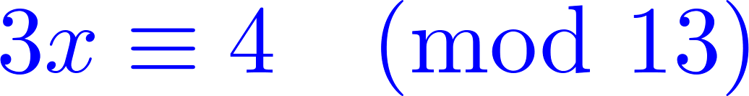
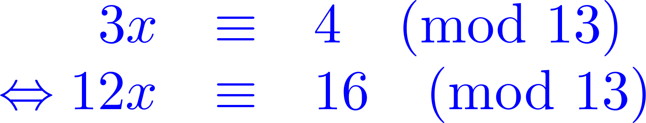
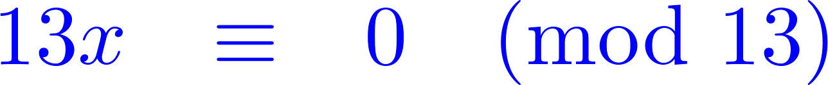
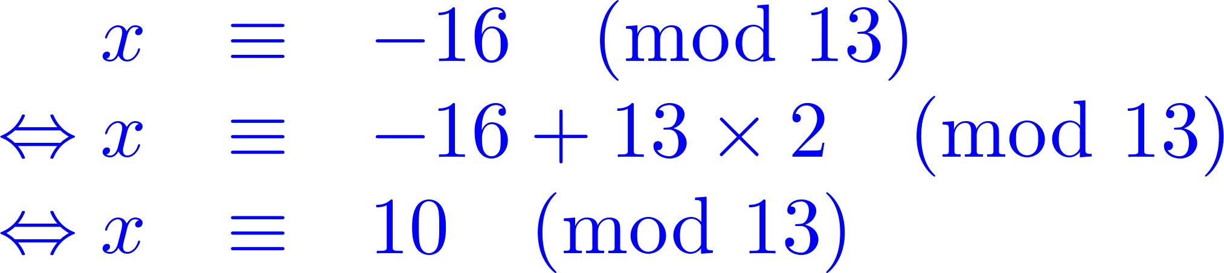
Congruence
Solve the congruence
(1)
We have
(2)
(2)-(1) then,
How can we solve the general problem? Where do the eq. (1), (2) come from?
Notes:
We divide the number by 7
8

Slide 9
Congruence
First, find a linear equation
Second, from
(2)+(1) then,
(*)
(1)
(2)
Notes:
We divide the number by 7
9

Slide 10



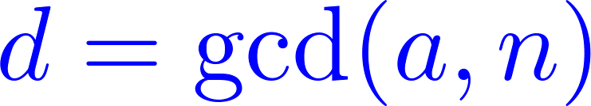
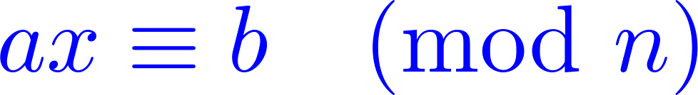


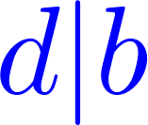
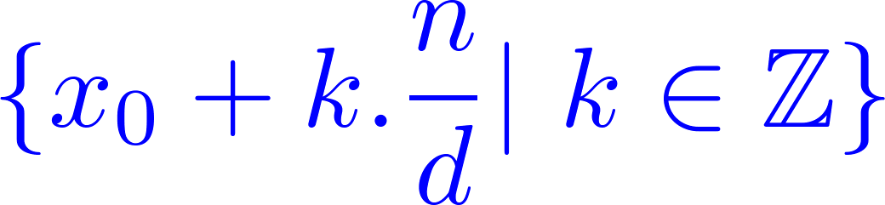

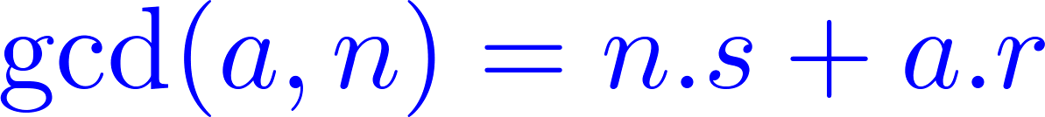
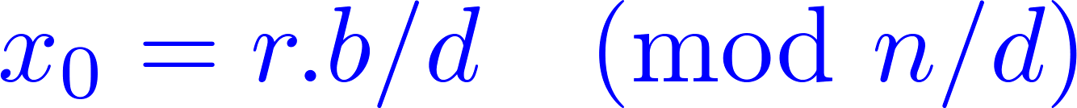
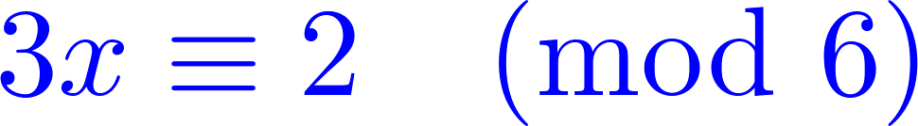
Congruence
Linear Congruence Theorem
If and are any integers, is a positive integer,
then the congruence
has solution if and only if is divisible by ( )
and the set of all solution is given by
where is one solution. How to find ?
Find , then
e.g. has no solution.
Notes:
We divide the number by 7
10

Slide 11

Congruence
Find
Check if then (1) has roots, otherwise no root.
If then
Find
Find
All roots

Slide 12
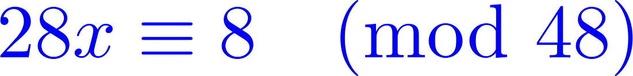
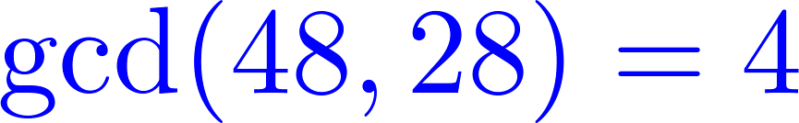
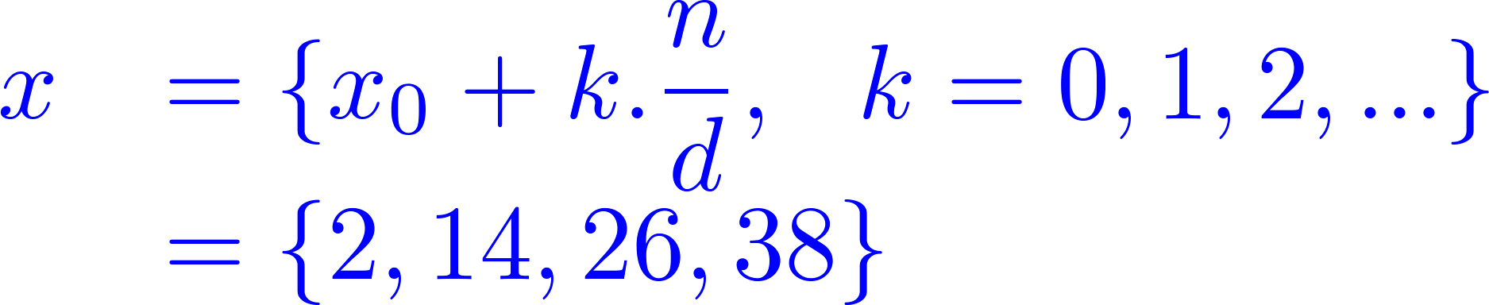
Euclidean Algorithm
Find if
Euclidean Algorithm
Dividend | Divisor | Quotient | Remainder
48 | 28 | 1 | 20
28 | 20 | 1 | 8
20 | 8 | 2 | 4
8 | 4 | 2 | 0
4=20-8.2 | 4 = 20.(1) + 8.(-2)
4=20-2(28-20.1)
4=20.3-28.2 | 4 = 28.(-2) + 20.(3)
4=(48-28).3-28.2
4=48.3-28.5 | 4 = 48.(3) + 28.(-5)
Notes:
Greatest common devisor
12

Slide 13

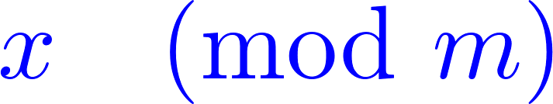
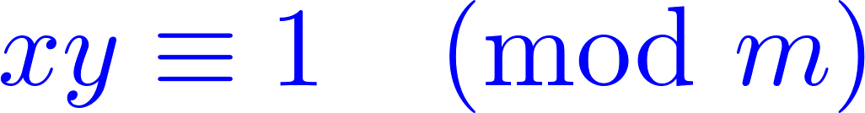
Multiplicative Inverse
is called the multiplicative inverse of
if
2 is multiplicative inverse of 4 mod 7
because 2 x 4 ≡ 1 mod 7
5 is multiplicative inverse of 3 mod 7
because 5 x 3 ≡ 1 mod 7
0 has no multiplicative inverse mod 7
2 has no multiplicative inverse mod 6
Notes:
We divide the number by 7
13

Slide 14
Theorem
Let m, x be positive numbers such that gcd(m,x)=1. Then x has a multiplicative inverse mod m, and it is unique.
Proof:
Consider 0x, 1x, …, (m-1)x. If there exists 0 ≤ a < b ≤ m-1, such that ax = bx mod m. Then ax – bx = 0 mod m. (a – b)x = 0 mod m. Since gcd(x,m)=1, a – b is an integer multiple of m. This is not possible. Therefore, 0x, 1x, …, (m-1)x are all distinct values mod m. ax = 1 mod m for exactly one a.
Notes:
Greatest common devisor
14

Slide 15
Multiplicative Inverse
(d,a,b) e_gcd(x,y) {
if (y = = 0) then return (x, 1, 0)
else {
(d, a, b) = e_gcd(y, x mod y)
return (d, b, a - (x div y) * b)
}
}
e_gcd(7, 3) // x = 7, y = 3
(d,a,b)=e_gcd(3, 1) // 1 = 7 mod 3, x = 3, y = 1
(d,a,b)=e_gcd(1, 0) // 0 = 3 mod 1, x = 1, y = 0
return (1, 1, 0) // d = 1, a = 1, b = 0
return (1, 0, 1) // d = 1, a = 0, b = 1
return (1, 1, -2)
Notes:
Greatest common devisor
15

Slide 16
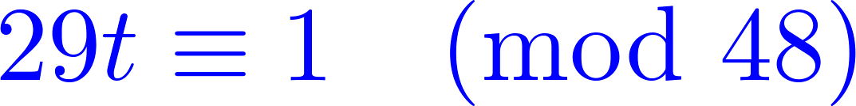
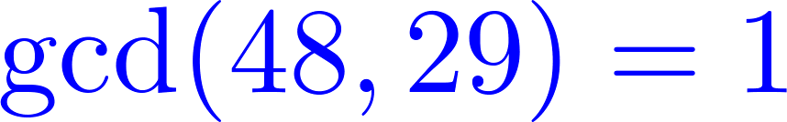

Multiplicative Inverse
Find the inverse of 29 in modulo 48
Euclidean Algorithm
Dividend | Divisor | Quotient | Remainder
48 | 29 | 1 | 19
29 | 19 | 1 | 10
19 | 10 | 1 | 9
10 | 9 | 1 | 1
9 | 1 | 9 | 0
1=10-9 | 1 = 10.(1) + 9.(-1)
1=10-(19-10.1)
1=10.2-19 | 1 = 19.(-1) + 10.(2)
1=(29-19.1).2-19
1=29.2-19.3 | 1 = 29.(2) + 19.(-3)
1=29.2-(48-29.1).3
1=29.5-48.3 | 1 = 48.(-3) + 29.(5)
Notes:
Greatest common devisor
16

Slide 17
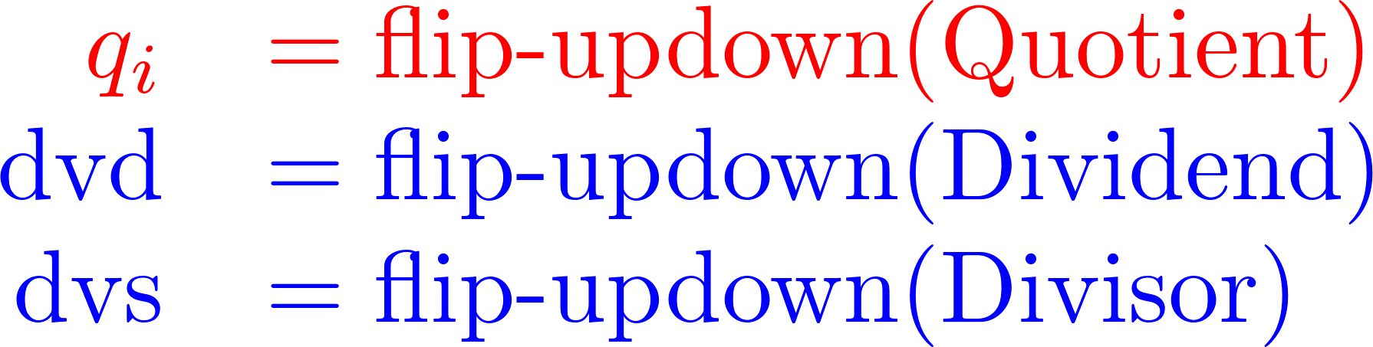
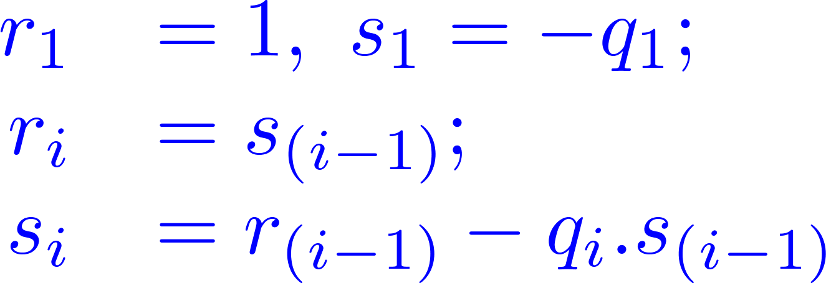
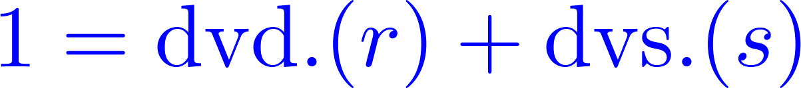
Multiplicative Inverse
Dividend | Divisor | Quotient | Remainder
48 | 29 | 1 | 19
29 | 19 | 1 | 10
19 | 10 | 1 | 9
10 | 9 | 1 | 1
9 | 1 | 9 | 0
dvd | r | dvs | s
10 | 1 | 9 | -1
19 | -1 | 10 | 2
29 | 2 | 19 | -3
48 | -3 | 29 | 5
Remove this row
Euclidean Algorithm
1 = 10.(1) + 9.(-1)
1 = 19.(-1) + 10.(2)
1 = 29.(2) + 19.(-3)
1 = 48.(-3) + 29.(5)
Notes:
Greatest common devisor
17

Slide 18
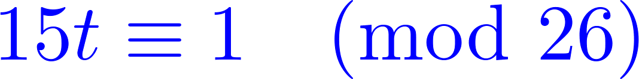


Multiplicative Inverse
Find the inverse of 15 in modulo 26
Extended Euclidean Algorithm
Dividend | Divisor | Quotient | Remainder
26 | 15 | 1 | 11
15 | 11 | 1 | 4
11 | 4 | 2 | 3
4 | 3 | 1 | 1
3 | 1 | 3 | 0
Step
0 | p0=0
1 | p1=1
2 | p2=0-1.(1) mod 26 = 25
3 | p3=1-25.(1) mod 26 = 2
4 | p4=25-2.(2) mod 26 = 21
 | p5=2-21.(1) mod 26=-19 mod 26 = 7
Notes:
Greatest common devisor
18

Slide 19



Cryptography
Alice’s
encryption
key
Bob’s
decryption
key
K
K
A
B
plaintext
encryption
algorithm
ciphertext
decryption
algorithm
plaintext
symmetric key crypto: sender, receiver keys identical
public-key crypto: encryption key public, decryption key secret (private)
Notes:
Greatest common devisor
19

Slide 20
Symmetric Key Cryptography
substitution cipher: substituting one thing for another
monoalphabetic cipher: substitute one letter for another
plaintext: abcdefghijklmnopqrstuvwxyz
ciphertext: mnbvcxzasdfghjklpoiuytrewq
E.g.:
Plaintext: bob. i love you. alice
ciphertext: nkn. s gktc wky. mgsbc
Q: How hard to break this simple cipher?:
brute force (how hard?)
other?
Notes:
Greatest common devisor
20

Slide 21
Symmetric Key Cryptography
K
K
A-B
A-B
plaintext
message, m
encryption
algorithm
ciphertext
decryption
algorithm
plaintext
m = K ( )
K (m)
K (m)
A-B
A-B
A-B
symmetric key crypto: Bob and Alice share know same (symmetric) key: K
e.g., key is knowing substitution pattern in mono alphabetic substitution cipher
Q: how do Bob and Alice agree on key value?
A-B
Notes:
Greatest common devisor
21

Slide 22
Symmetric Key Crypto.: DES
DES: Data Encryption Standard
US encryption standard [NIST 1993]
56-bit symmetric key, 64-bit plaintext input
How secure is DES?
DES Challenge: 56-bit-key-encrypted phrase (“Strong cryptography makes the world a safer place”) decrypted (brute force) in 4 months
no known “backdoor” decryption approach
making DES more secure:
use three keys sequentially (3-DES) on each datum
use cipher-block chaining
Notes:
Greatest common devisor
22

Slide 23
Symmetric Key Crypto.: AES
AES: Advanced Encryption Standard
new (Nov. 2001) symmetric-key NIST standard, replacing DES
processes data in 128 bit blocks
128, 192, or 256 bit keys
brute force decryption (try each key) taking 1 sec on DES, takes 149 trillion years for AES
Notes:
Greatest common devisor
23

Slide 24
Public Key Cryptography
symmetric key crypto
requires sender, receiver know shared secret key
Q: how to agree on key in first place (particularly if never “met”)?
public key cryptography
radically different approach [Diffie-Hellman76, RSA78]
sender, receiver do not share secret key
public encryption key known to all
private decryption key known only to receiver
Notes:
Greatest common devisor
24

Slide 25
Public Key Cryptography
+
Bob’s public
key
K
B
-
Bob’s private
key
K
B
plaintext
message, m
encryption
algorithm
ciphertext
decryption
algorithm
plaintext
message
+
K (m)
-
+
B
m = K (K (m))
B
B
Notes:
Greatest common devisor
25

Slide 26
Public Key Encryption Algorithm
Requirements:
.
.
+
-
1
need K ( ) and K ( ) such that
B
B
-
+
K (K (m)) = m
B
B
2
+
given public key K , it should be impossible to compute private key K
B
-
B
RSA: Rivest, Shamir, Adelson algorithm
Notes:
Greatest common devisor
26

Slide 27
Asymmetric Key: RSA
Choose two large random prime numbers p and q
Compute n = pq, n is used as the modulus for both the public and private keys.
Compute z = (p-1)(q-1)
Choose an integer e such that 1 < e < z, and gcd(e,z) = 1 (e, z are relatively prime). (n,e) is released as the public key.
Compute d as a multiplicative inverse of e modulo z, i.e. ed mod z=1. (n,d) is kept as the private key.
Notes:
Greatest common devisor
27

Slide 28



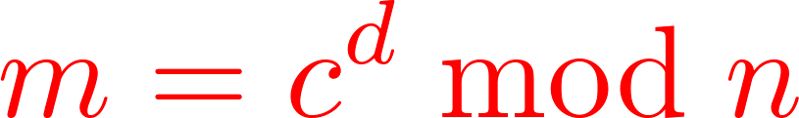

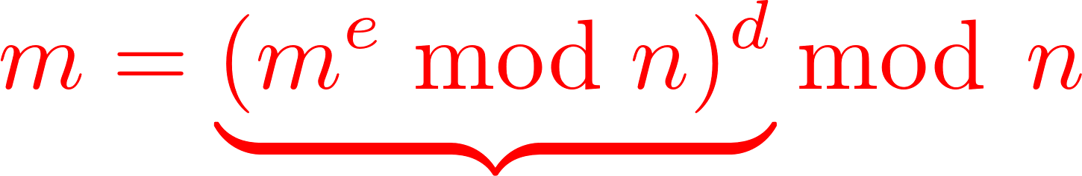

RSA: Encryption, Decryption
0. Given (n,e) and (n,d) as computed above
1. To encrypt bit pattern, m, compute
(i.e., remainder when is divided by )
2. To decrypt received bit pattern, c, compute
(i.e., remainder when is divided by )
Magic
happens!
Notes:
Greatest common devisor
28

Slide 29
RSA: Example
Bob chooses p=5, q=7. Then n=35, z=24.
e=5 (so e, z relatively prime).
d=29 (so ed-1 exactly divisible by z).
m
e
e
letter
m
c = m mod n
encrypt:
l
12
248832
17
d
d
c
c
m = c mod n
letter
decrypt:
17
481968572106750915091411825223071697
12
l
Notes:
Greatest common devisor
29

Slide 30
RSA: Why
Useful number theory result: If p,q prime and
n = pq, then:
y
y mod (p-1)(q-1)
x mod n = x mod n
e
d
ed
(m mod n)
mod n = m mod n
ed mod (p-1)(q-1)
= m mod n
(using number theory result above)
1
= m mod n
(since we chose ed to be divisible by
(p-1)(q-1) with remainder 1 )
= m
Notes:
Greatest common devisor
30

Slide 31
RSA:Another Important Property
The following property will be very useful later:
-
+
+
-
K (K (m)) = m
=
K (K (m))
B
B
B
B
use public key first, followed by private key
use private key first, followed by public key
Result is the same!
Notes:
Greatest common devisor
31

